Slide 1
Optimizing review feeding process through Topic Modeling

Slide 2
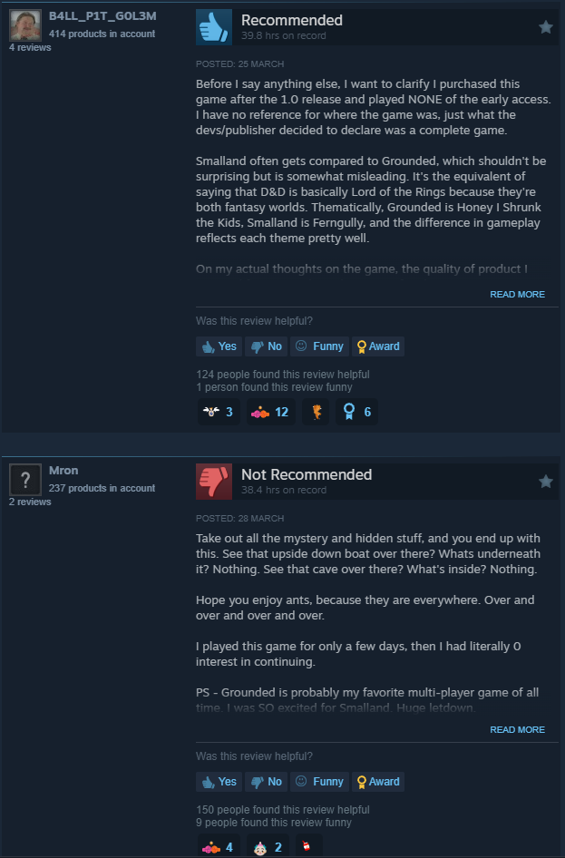
Background
What is Steam? Largest Digital distribution platform for video game publishing
How does it differ from other review system?
Instead of a 5-star rating scale, Steam asks users to simply indicate whether they recommend a game or not

Slide 3

Problem statement
According to "Customer engagement and online reviews." from Journal of Consumer Behavior
User reviews on platforms can influence over 70% of purchasing decisions.
The study further highlights that reviews with a balanced ratio of positive to negative reviews tend to have a 50% higher likelihood of being considered by new users.
This underscores the critical need for a sophisticated review feeding system that not only presents reviews but balances them in a way that reflects true user sentiment, enhancing decision-making for potential buyers

Slide 4
Project Goals
Develop a well-designed review system to improve user’s purchase experience:
Provide a balanced view of game reviews
-Avoid displaying disproportionate positive or negative reviews
Minimize redundancy in reviews displayed
-Avoid displaying reviews with similar topic on a single page
Prioritize reviews with voting scores
-Assuming reviews with up votes are high-quality, useful reviews

Slide 5
Data
Column name | Note | Data types | example
app_id | Game ID | integer | 10
app_name | Game name | object | Counter-Strike
review_text | Review text | object | Ruined my life. 10/10
review_score | 1 or -1, Whether the review recommends the game or not. | integer | 1
review_votes | 1 or 0, whether the review was recommended by another user or not | integer | 0
Source: Kaggle
Published date: October 2, 2017
Data size: 6.4 million reviews
Example game:
Notes:
Since we are doing review feeding optimization, therefore the analysis is conducted within each game. We decide to use a very popular game as the example for our presentation today. Which is Call of Duty.

Slide 6
Data preprocessing
review_text
:(
Cancer
Cancer
♥♥♥♥.
bored.
Remove reviews that have only one word
Reviews in only one word may not provide enough context or detailed feedback to be useful in analysis or decision-making processes
Counts of one-word reviews removed: 368

Slide 7
Data preprocessing
review_text
THEY ACTUALLY BROUGHT MOD TOOLS, LEVEL EDITOR ...
♥♥♥♥♥♥♥ IT !
I WANT MY MONEY BACK I DO NOT SUGGEST UNLESS Y...
░░░░░░░░░░░█▀▀░░█░░░░░░ ░░░░░░▄▀▀▀▀░░░░░█▄▄░░░...
OUR ISSUE IN MIDDLE EAST THE SERVER EVEN U HAV...
Remove reviews that are in all caps
Nielsen Norman Group, a leader in user experience research, has discussed how using all caps in texts reduces readability and user engagement.
They explain that text written in all uppercase letters forces the reader to slow down to interpret the message, leading to a poorer user experience.
Counts of all-caps reviews removed: 373

Slide 8
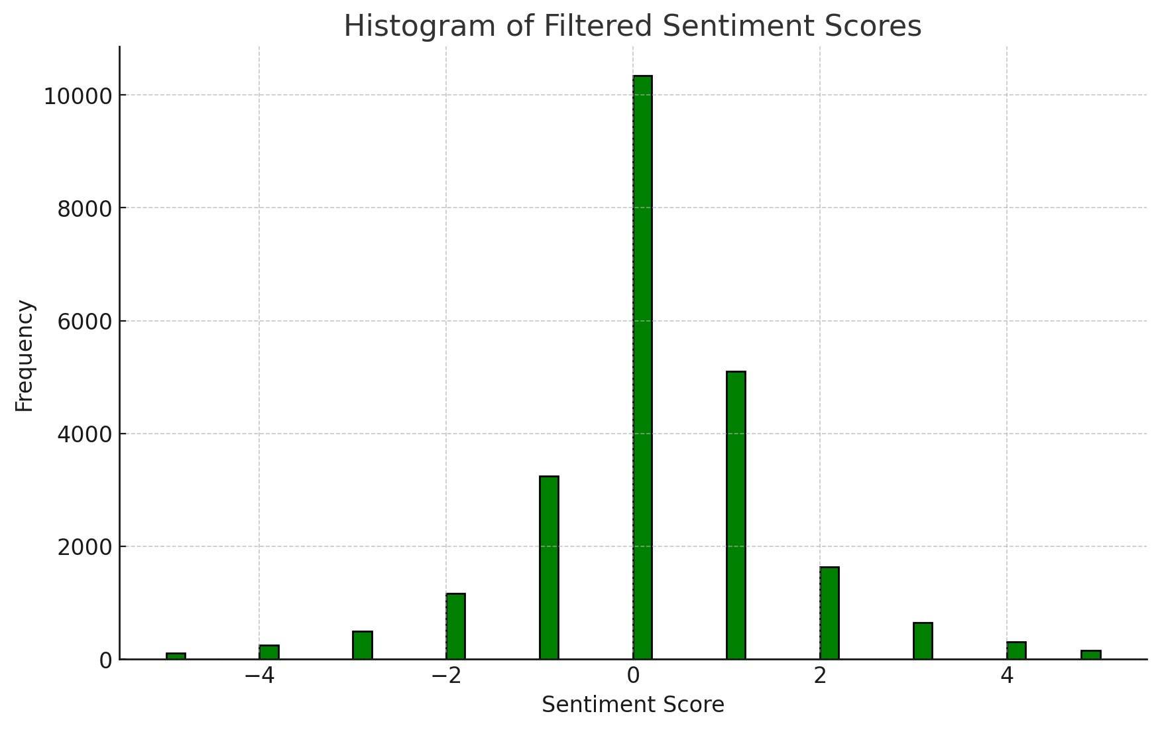
Data preprocessing
Remove reviews that display extreme emotions
-the 1st percentile is at a sentiment score of -5.0.
-the 99th percentile is at a sentiment score of 5.0.
-Filter out reviews which sentiment scores are below -5.0 and above 5.0

Slide 9
Topic Modeling with LDA
Model training:
Latent Dirichlet Allocation (LDA) models are trained separately on positive and negative reviews.
Model Application:
LDA models are used to understand the main topics within the reviews and analyzing the cosine similarity between reviews using the U-matrix from the LDA output and ensuring diverse reviews are displayed on each page.

Slide 10
Topic Modeling with LDA
Positive:
"zombie","get","like","map","multiplayer","campaign","good","make","thing","play"
Discussion about gameplay involving zombies, likely a specific multiplayer or campaign modes.
Negative:
"pc","crash","refund","fix","problem","computer","lag","unplayable","run","get"
Topic concentrate on technical difficulties

Slide 11
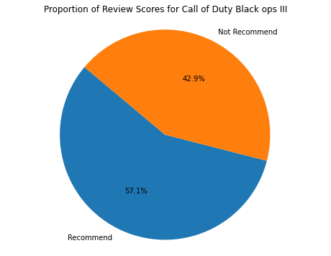
System Design
Review Sorting Mechanism
-Prioritization based on review votes
Review Balancing Mechanism
-Allocation of review slots based on proportion of review scores
Review diversification Mechanism
-use cosine similarity metrics to compare review topic distributions, ensuring that reviews with similar topics are not placed on the same page to enhance content variety.

Slide 12
Outcome First page review generated
App_name | review_text | review_score | review_votes
Call of Duty: Black Ops III | Call of Duty: Black Ops III is a game which I ... | -1 | 1
Call of Duty: Black Ops III | Let's all agree we got this for zombies | 1 | 1
Call of Duty: Black Ops III | It only took until 2065 for soldiers to finall... | 1 | 0
Call of Duty: Black Ops III | Updated 4/08/2016 MULTIPLAYER REVIEW ONLY | -1 | 1
Call of Duty: Black Ops III | game costs €99,99 and has microtransactions in... | -1 | 1
Call of Duty: Black Ops III | Only for zombies | 1 | 1
Call of Duty: Black Ops III | Over 10 GB worth of updates, and not a single ... | -1 | 1
Call of Duty: Black Ops III | 'Individual DLCs can no longer be purchased fo... | -1 | 1
Call of Duty: Black Ops III | Loaded up game &gt; Maxed settings &gt; Loaded... | -1 | 1
Call of Duty: Black Ops III | Activsion has done it again. Black Ops 3 is o... | -1 | 1
Review with up-votes are prioritized.
Reviews with extreme emotions are ruled out to reduce bias
Reviews written in ALL caps are ruled out for readability
Reviews written in one word are ruled out to increase the overall quality of reviews
Review slots are allocated based on proportion of review score: in this case 6:4
app_name | review_text | review_score | review_votes | sentiment_score
Call of Duty: Black Ops III | Until BO3 I have had little to no interest in ... | 1 | 1 | 4
Call of Duty: Black Ops III | Almost all of FPS issues have been fixed. | 1 | 1 | 0
Call of Duty: Black Ops III | I really dont know what everyone else is ♥♥♥♥♥... | 1 | 1 | 0
Call of Duty: Black Ops III | this is best call of duty ever!!! | 1 | 1 | 1
Call of Duty: Black Ops III | after reading some of the other reviews my hea... | 1 | 1 | 3
Call of Duty: Black Ops III | it was awsome | 1 | 1 | 0
Call of Duty: Black Ops III | I like when the game loads and the textures ju... | -1 | 1 | 0
Call of Duty: Black Ops III | This game is cancer. | -1 | 1 | 0
Call of Duty: Black Ops III | Call of Duty: Black Ops III is a game which I ... | -1 | 1 | 1
Call of Duty: Black Ops III | I'm waiting since Modern Warfare to get a COD ... | -1 | 1 | 0

Slide 13
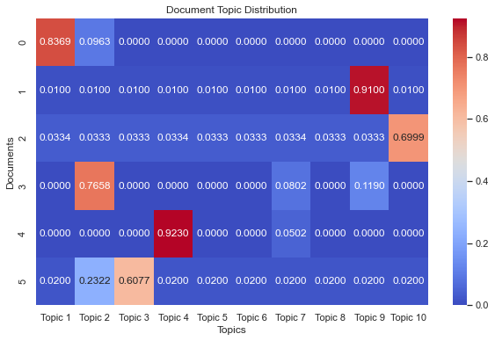
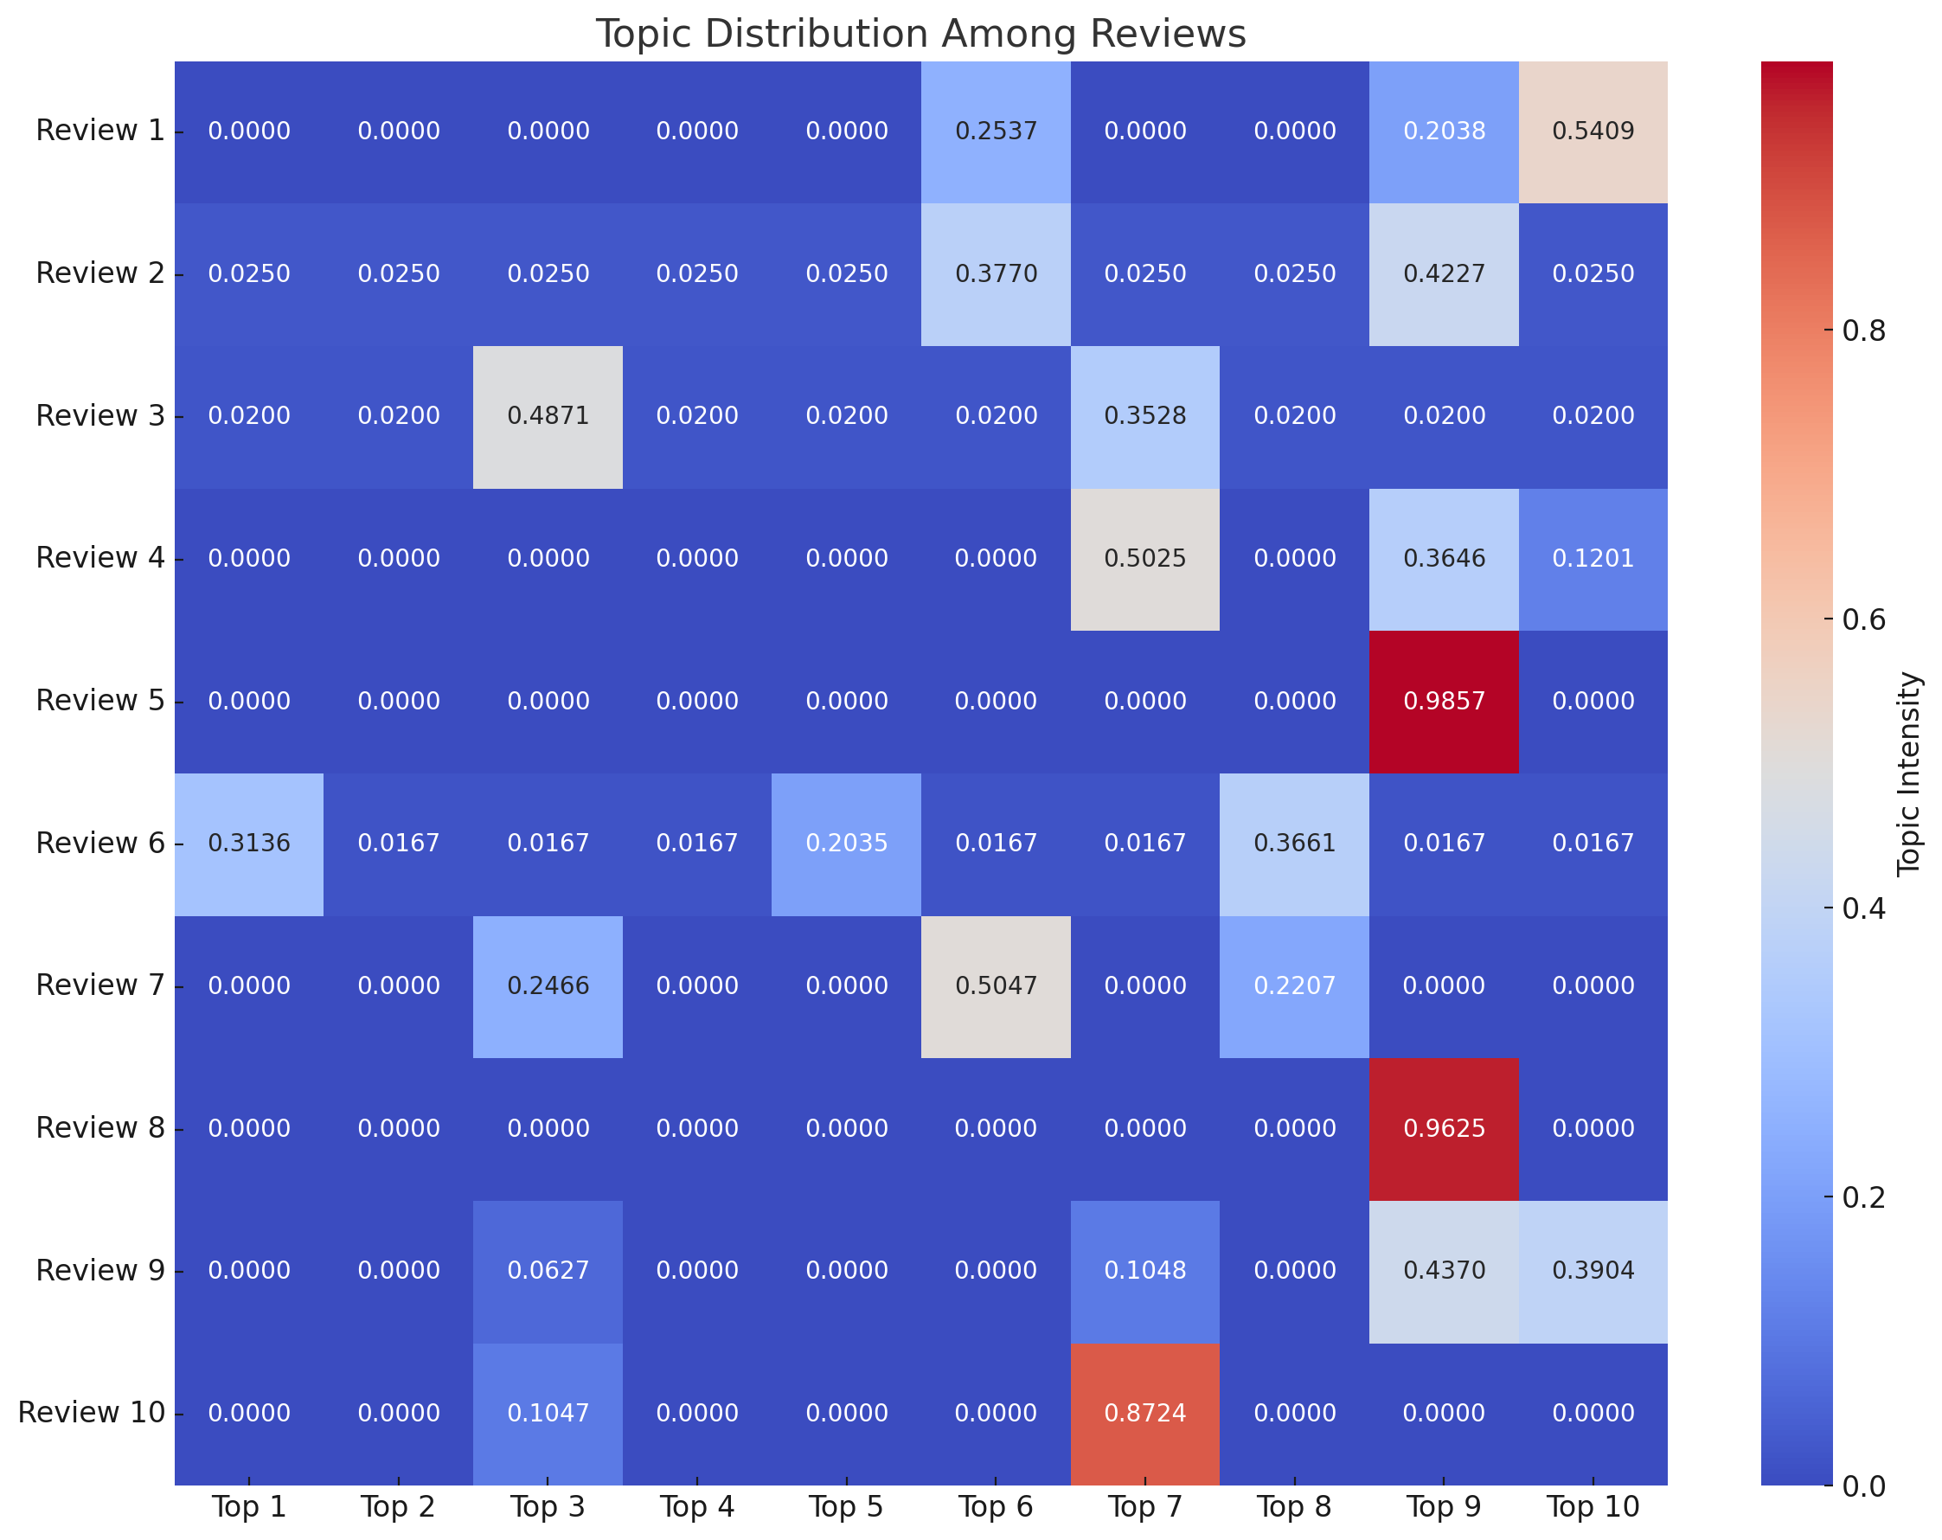
Outcome Topic diversification
6 positive reviews generated in first page distribute across different topics defined by LDA model.
After
Before

Slide 14
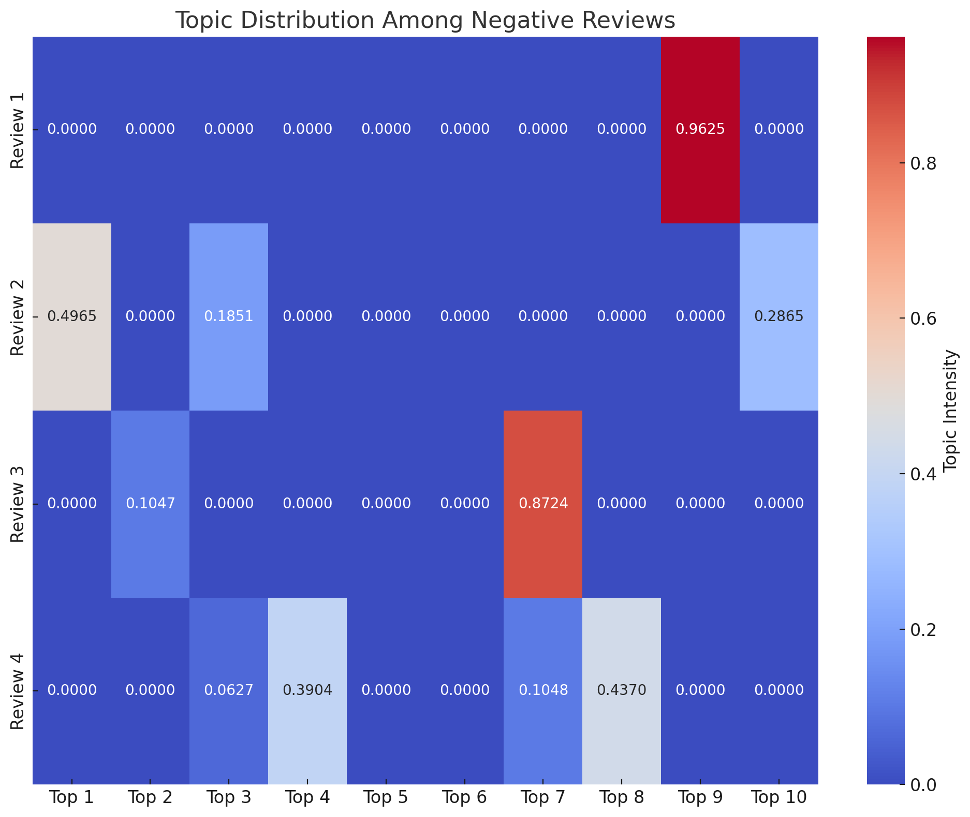
Negative reviews diversification
Negative reviews topic of “Call of Duty Back Op III” on the first page are diverse after our sorting system

Slide 15
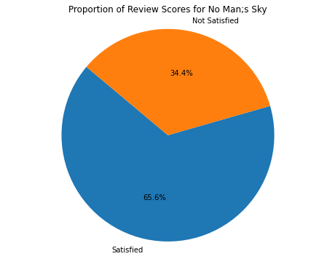
Example II : No Man’s Sky
Review with up-votes are prioritized.
Reviews with extreme emotions are ruled out to reduce bias
Reviews written in ALL caps are ruled out for readability
Reviews written in one word are ruled out to increase the overall quality of reviews
Review slots are allocated based on proportion of review score: in this case 7:3

Slide 16
Example II: Comparison
 | app_id | app_name | review_text | review_score | review_votes | Processed Review Text | sentiment_score
3368116 | 275850 | No Man's Sky | A lot of people seem to be upset with this gam... | 1 | 1 | [lot_people, seem, upset, however_enjoy, play,... | 1
3368118 | 275850 | No Man's Sky | I have spent over 200 hours playing this game ... | 1 | 1 | [spent_hour, play_still, find_enjoyable, game,... | -1
3368120 | 275850 | No Man's Sky | FOR THOSE WHO ARE STUCK @ WHITE 'INITIALISING'... | 1 | 1 | [stuck_white, initialise_screen, press_hold, e... | 0
3368119 | 275850 | No Man's Sky | So here is the rub. To be honest, this game is... | 1 | 1 | [rub, honest, pretty_boring, repetative, yeah,... | 1
3368126 | 275850 | No Man's Sky | IDK why everyone is ♥♥♥♥♥ing about. First 10 m... | 1 | 1 | [idk, everyone, ing, first_min, fix_ship, next... | 0
3357654 | 275850 | No Man's Sky | This was my review prior to the 1.1 update ___... | 1 | 1 | [review, prior, update, fail, miserably, annoy... | 9
3368121 | 275850 | No Man's Sky | I bought this with my No Man's Sky refund | 1 | 1 | [buy_man, sky, refund] | 0
3374046 | 275850 | No Man's Sky | ignore the recommended specs i guess recommend... | -1 | 1 | [ignore, recommended, spec, guess, recommend, ... | -1
3377595 | 275850 | No Man's Sky | Worst game ever | -1 | 1 | [worst_ever] | -1
3377609 | 275850 | No Man's Sky | Not worth $60. | -1 | 1 | [worth] | 0
app_name | review_text | review_score | review_votes
No Man's Sky | This was my review prior to the 1.1 update ___... | 1 | 1
No Man's Sky | If they keep updating it, I'll keep playing it. | 1 | 1
No Man's Sky | Look, this game received a ton of flak. Howeve... | 1 | 1
No Man's Sky | The 1.1 update is amazing. If you still have t... | 1 | 1
No Man's Sky | This game is 100% exploration. Hardly any comb... | 1 | 1
No Man's Sky | This is a very educational game that teaches y... | 1 | 1
No Man's Sky | 16 hours played for me and it only came out to... | 1 | 1
No Man's Sky | INTRO This review covers a lot of the politica... | 1 | 1
No Man's Sky | The game was boring and repetative, everyone ♥... | 1 | 1
No Man's Sky | I think the game was rushed for its initial sc... | 1 | 1

Slide 17
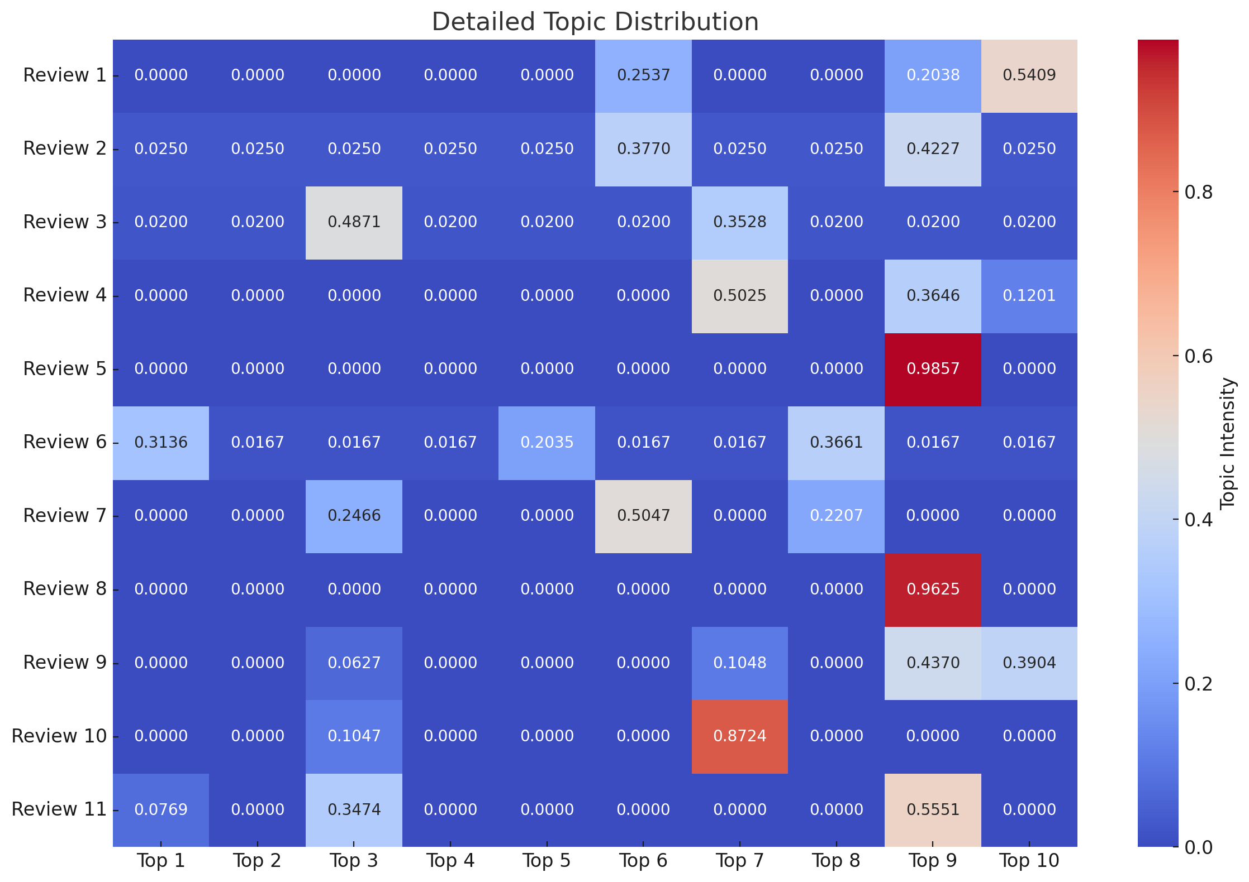
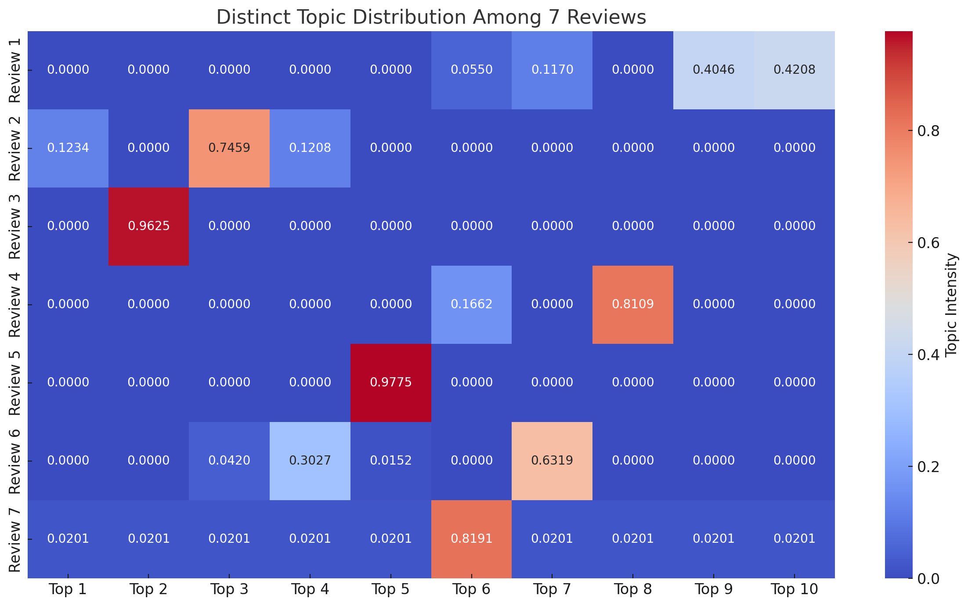
Example II: Comparison

Slide 18
Conclusion
Our sorting system are designed to achieve:
Allocating Review slots are based on proportion of review score.
Ruling out reviews that are biased, low-readability and low-quality
Prioritizing reviews that have up-votes
Ensuring diverse reviews are displayed on each page.
Provide an overall better purchasing experience for users.

Slide 19
Future work
Model Optimization: hyperparameters tuning like the number of topics, alpha, and beta to optimize coherence and perplexity scores.
User Feedback Integration: implement upvotes and downvotes for users to provide feedback and using this data to further refine the models

Slide 20
Thank you

Slide 21
Reference
Davis, M., & Hunt, J. (2017). Visual Communication Design. Bloomsbury Visual Arts.
Rakhi T.(2018). Customer engagement and online reviews. Journal of Retailing and Consumer Services, Volume 41,
Antoni Sobkowicz. (2017). Steam Review Dataset (2017) [Data set]. Zenodo. https://doi.org/10.5281/zenodo.1000885

